Slide 1

HYDRO INNOVATE
Siri Belur Chandrashekar
Ashwin Kumar Ponnala
Chandu Pulapaka
Bhanu Prakash Racha
Rohitha Sanagala
Lakshmi Bindu Sangem
Madan Jaswant Rahul Saravana Iyyappan
Pushpanjali Sarigommula

Slide 2
AGENDA
Introduction
Team
Existing Problems
Vision Of The Future
Proposed Future Product
Tier 3 Non-Consumer
Demand and Supply
Conclusion

Slide 3


EXISTING PROBLEMS
Water Scarcity
Increased in demand of water due to population growth, Urbanization, Industrialization
Droughts
Changing climate patterns including prolonged droughts

Slide 4
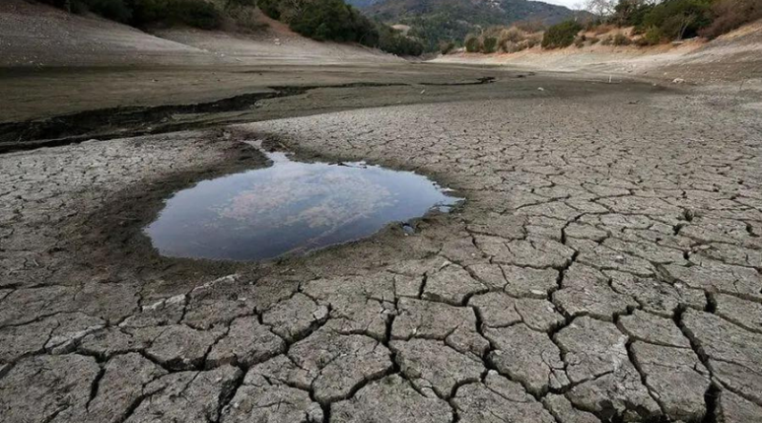

EXISTING PROBLEMS
Depletion of Underground water
Over-extraction of the underground water for agriculture, Industrial and
domestic purpose
Water related conflicts
Competition over limited water resources throughout nations

Slide 5



VISION OF THE FUTURE
Sustainability
Implementing innovative water management practices to ensure long-term environmental health and resource availability.
Disruption
Reimagining traditional water management boundaries through advanced technology and sustainable practices.
Accessibility
Providing affordable and efficient water management solutions to diverse communities, ensuring equitable access to clean water.

Slide 6


VISION OF THE FUTURE
Communities
Prioritizing reaching underserved communities to address water scarcity and improve quality of life.
Preservation
Ensuring the preservation of water resources for future generations through responsible management.
Innovation
Driving market leadership by continually innovating water management solutions to meet evolving needs.

Slide 7
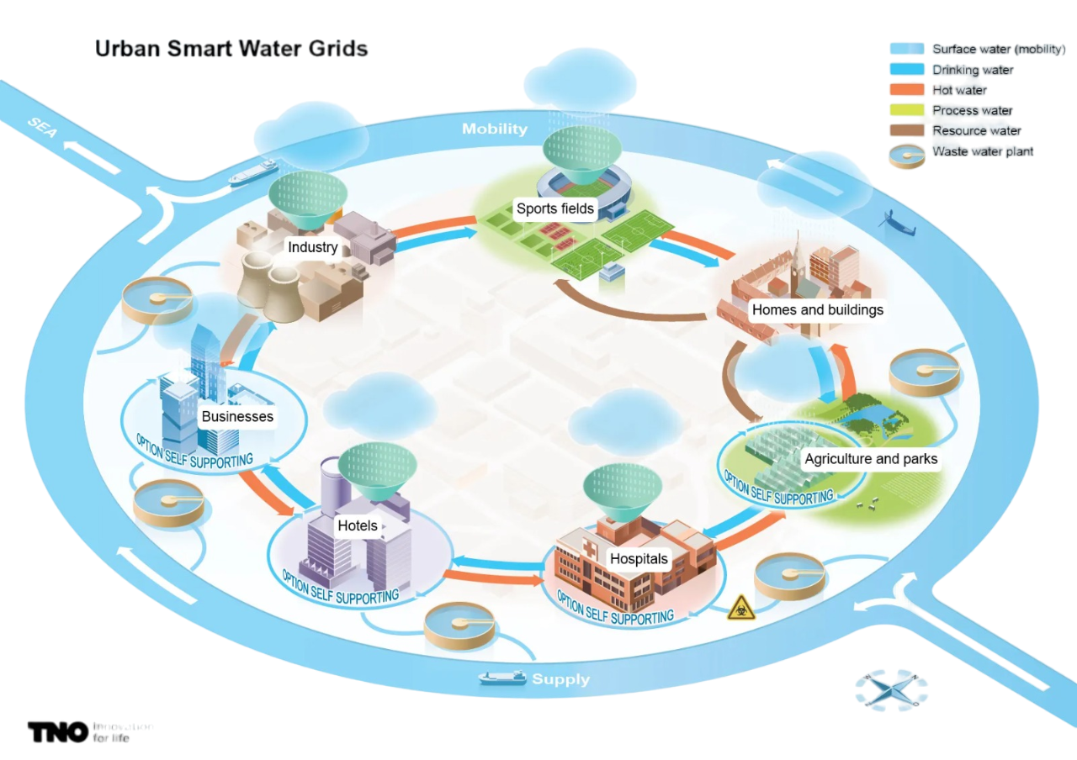
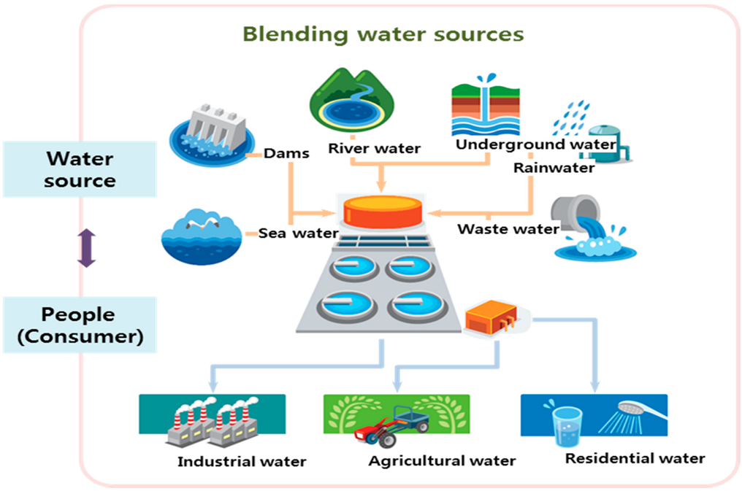
OUR PRODUCT
Utilizes advanced sensors and meters to monitor water usage in real-time.
Detect leaks and abnormalities in the water distribution system promptly.
Optimize water usage and identify areas for conservation
Enable more efficient allocation of resources by prioritizing water distribution based on demand and need.
Improve the overall reliability and resilience of water supply systems through remote monitoring

Slide 8
OUR PRODUCT
Our product is an advanced intelligent solution for futuristic water management
It incorporates cutting-edge technologies such as IoT, AI, and data analytics
Key features include an extensive network of sensors and IoT devices deployed throughout the water distribution system
These devices enable real-time monitoring of critical parameters like flow rate, pressure, and water quality
Data collected by the sensors are seamlessly transmitted to a central control system, forming the backbone of our intelligent water grid.

Slide 9

TIER 3 NON - COMSUMERS
Prepare for the Future: Smart grids are the future of water infrastructure, ensuring a reliable and efficient supply.
Improved Water Quality: Smart systems can monitor water quality in real-time, notifying you of any potential issues.
Personalized Water Management: Smart grids can learn your water usage patterns and suggest ways to conserve.
Community Benefits: Smart grids can help reduce overall water consumption in your community, benefiting everyone.
Tech-Savvy Convenience: Embrace the future of technology and enjoy the convenience of a smart water system.

Slide 10
WHY OUR PRODUCT???
PRICE CORRIDOR OF MASS
•Basic System: $5,000 to $15,000
•Mid-Range System: $15,000 to $50,000.
•High-End System : $50,000 to $200,000
WHAT MAKES OUR PRODUCT WORTH IT?
Competitive Pricing
Value Proposition
Future-Proofing

Slide 11
DEMAND AND SUPPLY
Market Size: Expected to reach USD 93.24 Billion by 2030.
Growth Rate: CAGR of 18.57% from 2024 to 2030.
Key Drivers:
Demand for efficient water management systems.
Integration of smart technologies.
Government initiatives for sustainable water use.
Regional Dominance: North America holds the largest market share due to digitalization and smart technology influx. Revenue Estimation:
Pricing Strategy: Varied based on solution complexity, features, and market competition.
Sales Volume Forecasting: Based on market demand, share targets, and sales projections.
Revenue Calculation: Total revenue = Sales volume * Unit price.

Slide 12
DEMAND AND SUPPLY
Expense Estimation
Cost of Goods Sold (COGS)
Research and Development (R&D)
Marketing and Sales Expenses
Operational Expenses Technology and Infrastructure Costs
Regulatory Compliance Costs
Profit Margin Analysis
Profit Margin Calculation: (Total Revenue - Total Expenses) / Total Revenue * 100.
Factors Influencing Profit Margin: Economies of scale, pricing strategy, cost optimization, and market dynamics.
Importance of Profit Margin: Reflects efficiency in generating profits from operations.

Slide 13
CONCLUSION
Revolutionary Solution: Pioneering the future of water management with the Smart Water Grid.
Funding Ask: Seeking an investment of $5 million to bring this innovation to market.
Use of Funds:
Research & Development: $2 million
Production & Scale-up: $1.5 million
Marketing & Outreach: $1 million
Operations & Staffing: $0.5 million
Projected Returns: Anticipate revenue growth to $20 million within 5 years, capturing a significant smart water management market share.
Investor Benefits: Opportunity to invest in a high-growth with significant returns, sustainable technology.
Partner with us to make a global impact and secure a sustainable future.

